Slide 1

Alton 3G pitch
Chloe Davanna – East Hampshire District Council
Sacha Nicholas – Hampshire FA

Slide 2
Agenda
Welcome and introduction
Playing Pitch and Sports Facility Strategy
3G pitch strategic need
Site audits
Alton Town Council presentation

Slide 3
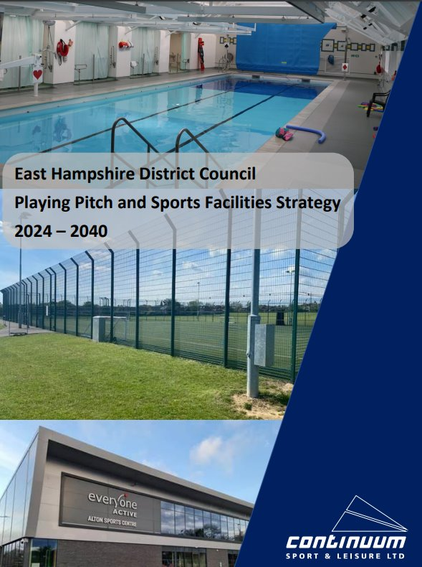
What is the Playing Pitch and Sports Facility Strategy
A Playing Pitch and Sports Facility Strategy is designed to set clear priorities for sport within the district;
Providing evidence to support management and investment decisions
Support the East Hampshire and SDNP local plans
Provide planning guidance in relation to sports provision and quality standards
Inform the allocation of s106 funding/CIL and other funding streams
Help to advance collaborative working with stakeholders

Slide 4
Scope of the Strategy
The Council agreed that the indoor sports facilities to be included in the strategy are:
Swimming Pools
Sports Halls
Health and Fitness venues (gyms, dance and exercise class/spin studios)
It was also agreed that the outdoor facilities to be included in the strategy are:
Rugby (Union & League
Cricket
Tennis including padel
Athletics and running
Squash
BMX and skate parks
Football
Hockey
Bowls and pétanque
Netball
Cycling
Golf

Slide 5
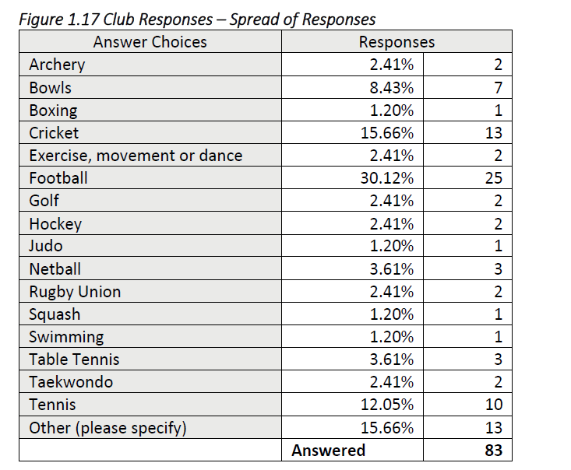
Engagement with organisations
Cricket 81% of teams
Football 83% of teams
Rugby 100% clubs
Hockey 100% clubs
The total number of responses was 83 covering 23 different sports.
31 Parish/Town Councils have responded, which covers those with sports facilities in their areas.

Slide 6
District strategic need
3 of 5 3G pitches across the district are currently at capacity
The strategy highlighted to meet current demand for football we need an additional 2.75 full sized FA 3G pitches.
To cater for future football demand this would equate to a further 0.75 pitch
The strategy also highlights that Rugby training areas are overplayed across the district
There are already plans for a 3G pitch at Bohunt School and at the Land East of Horndean development and assuming these can be delivered, an additional 1.5 pitches is needed.
It was agreed Petersfield and Alton areas would be considered to deliver these additional facilities.
Notes:
Make a comment that clubs are travelling outside the district or playing on alternative surfaces to meet training needs.
Alton Sports Centre has weekend capacity due to online being able to offer 5v5 matches.
TPS is nearly at capacity however as it’s the oldest 3G pitch there is now capacity for match play. No longer register
The number of 3G pitches is calculated on each team having access to one training sessions a week. This equates to estimated 38 teams to a pitch, however this would be subject to the permissions on the floodlights

Slide 7
Alton 3G pitch strategic need
Football Foundation have committed to delivering 40% of their investment into multi-sport facilities, working with the Rugby Football Union (RFU) it was agreed that Alton and Petersfield will provide multi-sport offers within East Hampshire District.
Team data
Alton area currently has 66 football teams comprising of 55 youth teams and 11 adult team.
Alton Rugby club has 10 teams comprising of 7 youth teams and 3 adult teams. As well as 6 youth squads.
All teams offer opportunities for women and girls to play either through mixed teams or female only. It's estimated that 248 women and girls are members of either a Rugby or Football Club in Alton.
Total teams requiring training provision in Alton: 82 teams
Based of this we would require a minimum of 2 full size 3G pitches to cater for the current demand.
Notes:
Clubs included are Alton Football Club, Manors Colts, Holybourne and some league teams. This does not take into consideration any small-sided leagues, recreational play and targeted community football development programmes.
Make a note that further discussion will need to be had to see if it will be match compliant for Rugby or training only.
38 teams per a 3G pitch

Slide 8
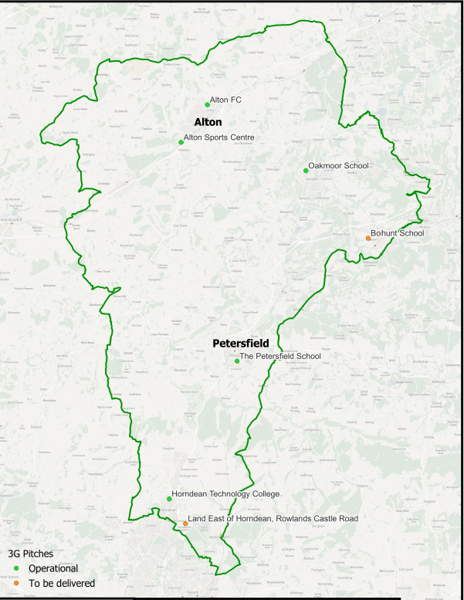

Map of 3G pitches

Slide 9
What have we done so far..
June 2024
November 2024
February 2025
Briefed the Town Council of the strategic need
July 2025
Briefed Town Council on the findings of the site audits
Playing Pitch and Sports Facility Strategy published
Carried out site audits in partnership with Alton Town Council
Football Foundation Local Football Facilities Plan was updated
December 2024
April 2025
Meet with local clubs to discuss the strategic need
Notes:
Note that

Slide 10
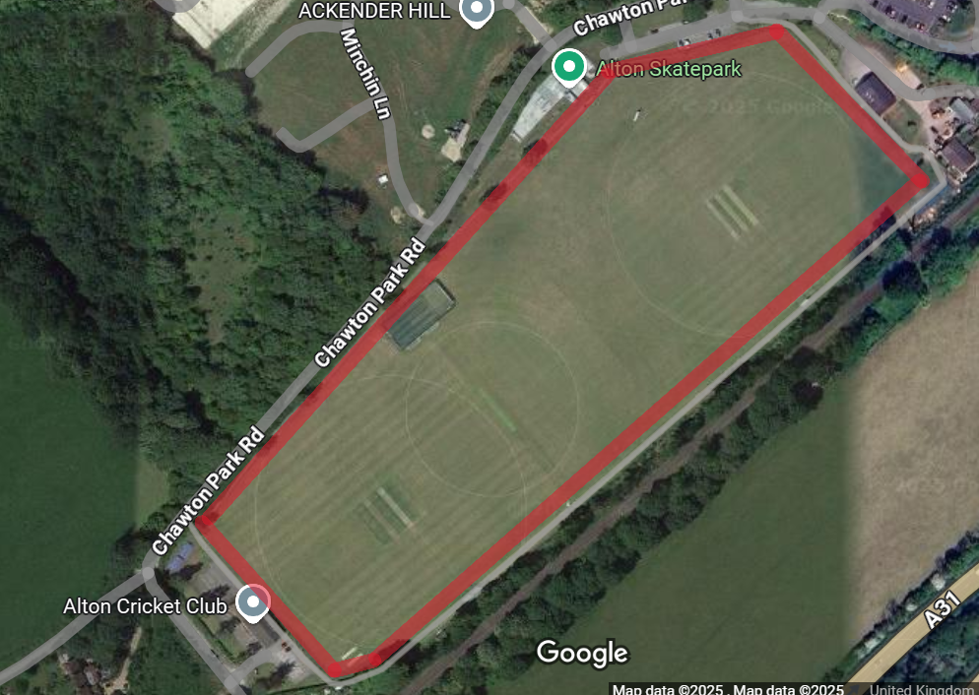
Jubilee Playing Fields
Strengths and Opportunities | Weakness and Threats
Could accommodate a 3G pitch | Strategic hub for cricket within Alton
Good access and accessibility for residents (Bus, Walking and Cycling routes) | Limited ability to enclose due to cricket requirements
Would create a wider sports hub with neighbouring leisure facilities | Limited parking in Town Council owned car parks
Already a well used site for football | Ancillary facilities will need to be upgraded to meet the 3G pitch requirements

Slide 11
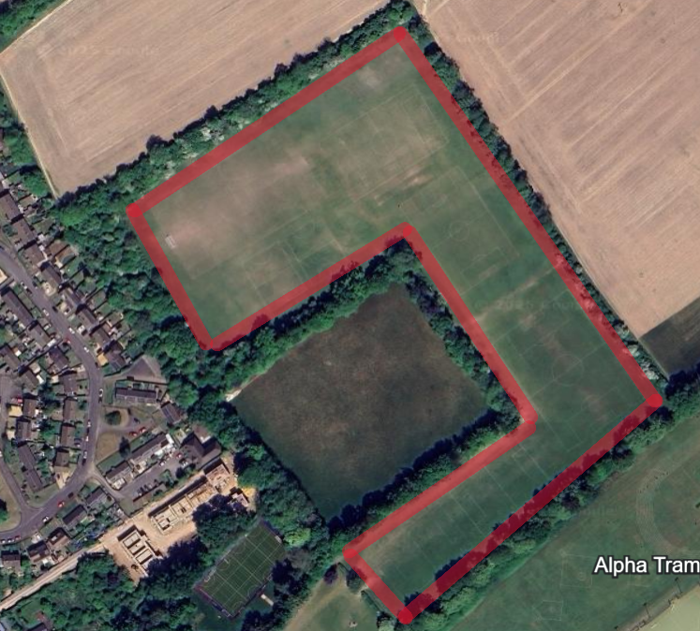
Diggers
Strengths and Opportunities | Weakness and Threats
Site is large enough to accommodate a 3G pitch | No ancillary facilities available onsite
Good access and accessibility for residents (Bus, Walking and Cycling routes) | No parking available at the site, so potential access issues
Site could be enclosed however impact needs to be considered on other user groups | No utilities available
Site is already well used by Football and could be used by Rugby | Has significant community value on how the space is utilised and accessed

Slide 12
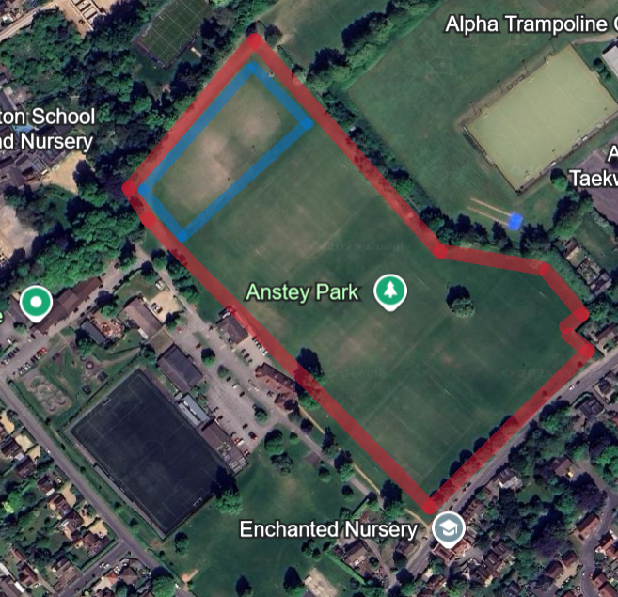
Anstey Park
Strengths and Opportunities | Weakness and Threats
Could accommodate a 3G pitch | Housing to the south of the site
Good access and accessibility for residents (Bus, Walking and Cycling routes and the train) | Parking is already constrained at peak times
Areas of Anstey Park are already enclosed and have ancillary facilities | Has significant community value on how the space is utilised and accessed. Consideration of access to rights of way and other users of the site
Site is already well used by Football and Rugby creating a sports hub | Existing 3G pitch onsite, partners would have to work together to ensure both are viable
Notes:
Blue section of the site is the area we looked at in detail, however the strengths and risk do relate to the whole site.
Anstey has 5.37ha, diggers has 4.32ha therefor 9.69ha across both sites, 3G pitch will take around 1ha of space is rugby compliant. Existing 3G pitch is 0.8ha

Slide 13

Alton 3G Pitch
Hayley Carter, Deputy Town Clerk
17th September 2025

Slide 14
ATC Sites
Each site was scored on a variety of things, including but not limited to:
Size to accommodate the facility
Site ownership
Partner club potential for training
Operational viability of location
Proximity to housing
Flood risk
Archaeology and heritage issues
Impact on ecology
Connectivity – pedestrian and cycle accessibility, public transport accessibility,
car / coach accessibility and parking

Slide 15
ATC Sites
Jubilee scored 48 and is ruled out
Diggers scored 61 and due to there being no ancillary facilities and utilities on-site the cost of delivering it on this site would be significantly higher. This could impact the deliverability of project as larger amount of funding would need to be secured.
Anstey Park scored 71 - having the existing infrastructure in place increases the chance for delivery and reduces the total cost of the project.
The preferred site and best chance for a project to be delivered in a timely manor would be Anstey Park. We would need to complete a full feasibility assessment and further public consultation.

Slide 16
Funding
The FA pays for the feasibility assessments (approx. £35,000)
The majority of the funding for the pitch comes from the Football Foundation (up to 70%)
Other funding would be sought from Community Infrastructure Levy (CIL), also known as developers contributions
For ongoing maintenance and eventual replacement of the pitch surface a proportion of the income generated from bookings (management structure tbc), would pay into a national pitch replacement fund which earns interest purely for this site

Slide 17
Anstey Park
Opportunity to improve parking – if additional parking spaces are needed as a planning condition the Football Foundation can build this into the cost. Therefore, they do not go out to tender until after planning permission has been granted
Continued access across the top of the site to Diggers
Plenty of space remains for dog walkers and recreational use
Screening could be used
Floodlights are already in existence in that location
Enables the town to maintain two main sport hubs – Jubilee and Anstey
Increasing requirement for sports provision in the town – other open spaces coming from development but not sports pitches

Slide 18
Consultation
Feedback forms available in paper at this meeting or from the Town Hall, Market Square, Alton GU34 1HD
Presentation and feedback forms are available on the Alton Town Council website – alton.gov.uk
Are you supportive of having a new 3G pitch in Alton?
Are you supportive of investigating Anstey Park as the preferred site?
If not, why not?
Any further comments.

Slide 19
Questions
Chloe Davanna – East Hampshire District Council
Sacha Nicholas – Hampshire FA
Hayley Carter – Alton Town Council

